Slide 1


EENG385 - Electronic Devices and Circuits
Lab 06:
Audio Board Buildup
Objective:
Study the design and layout of the audio board.
Complete the assembly
1

Slide 2
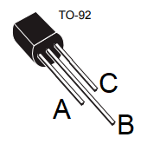
Components
Voltage Regulator
A circuit element that supplies a constant voltage to a load.
It has limits to the range of input voltages and load currents that it can handle.
2
2
Notes:
2

Slide 3
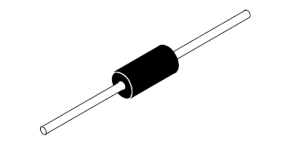
Components
Zener diode
It is widely used to regulate the voltage across small circuits.
3
3
Notes:
3

Slide 4
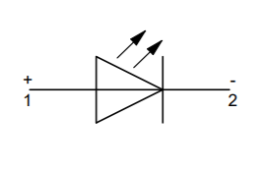
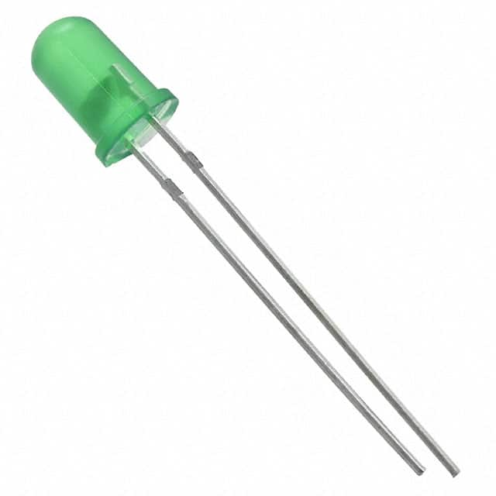
Components
Power-on LED
The power-on LED provides positive confirmation that power is bring delivered to the circuit.
This is a “must-add” to any PCB you are designing
4
4
Notes:
4

Slide 5
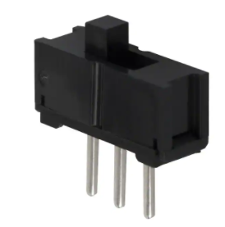
Components
On/Off switch
Our on/off switch has two positions .
5
5
Notes:
5

Slide 6
Turn in
Make a record of your response to numbered items below
LM7805 Questions 1 – 5
Zener Diode Questions 1 – 3
Power-on LED Questions 1 – 9
On/off switch Questions 1 – 5
Assemble Audio Board
Complete soldering of Audio board.
Test voltage outputs with DMM.
Assembly will be evaluated using soldering rubric.
6
6
Notes:
6

